Slide 1
Object Oriented Analysis and Design
Prepared by:
Pankaj Sharma

Slide 2
Agenda
Problem with Procedural Language
Abstraction overview
The story of object oriented programming
Practical use case on class and object
Introduction to object oriented analysis and design
System modelling
UML
Design principles and design patterns – concept
Design principles and design patterns - Practical
Case study
References

Slide 3
Problem with procedural languages
Data does not have an owner
Difficult to maintain data integrity
Functions are the building blocks
Many functions can modify a given block of code
Difficult to pinpoint bug sources when data is corrupted

Slide 4
Problem with procedural languages
Function 1
Function 3
Data
Function 2

Slide 5
Problem with procedural languages
Uninitialized variables
int k;
printf(“%d”,k);

Slide 6
Problem with procedural languages
Resource deallocation problems
Example: memory leaks, open files, open database connections, open network connections.
int *p;
p=(int*) malloc(1000);
p=(int*) malloc(1000);
p=(int*) malloc(1000);

Slide 7
Problem with procedural languages
Not enough support for abstraction
ADT = data + function
data : modelled as structure
functions: global, not related to structure

Slide 8
Abstraction Overview
“Abstraction focuses upon the essential characteristics of some object, relative to the perspective of the viewer”
By Grady Booch

Slide 9
Abstraction Overview
Abstraction

Slide 10
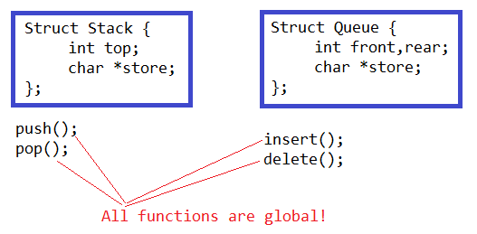
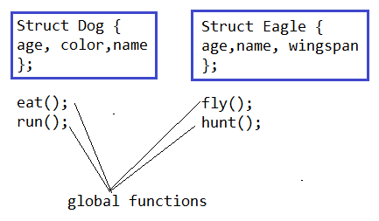
Problem with procedural languages
Compiler has no way of knowing about the structure which is going to allow different functions.

Slide 11
The story of object oriented programming
In object oriented programming, program will be….
Split into several small, manageable, reusable programs.
Each small program has its own identity, data, logic and how it’s going to communicate with rest of the other programs.

Slide 12


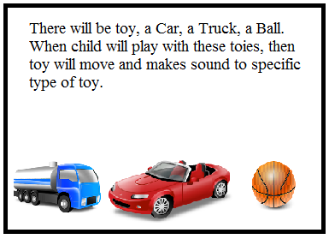

The story of object oriented programming – Practical case
Abhinav is a project manager, and once he gave the same specification to two of his programmers, Rajesh and Dinesh. He gave both of them a dead line to complete that
Rajesh
Expert in:
Procedure Oriented Programming
Dinesh
Expert in:
OOPs

Slide 13


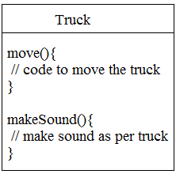
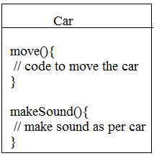
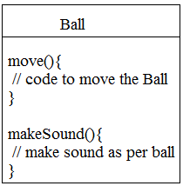
The story of object oriented programming
Rajesh and Dinesh went in their Cubical and started to create application structure with their know how.
move(ToyType){
// toy is moving
}
makeSound(ToyType){
// use toytype to make the toy specific
//sound
}

Slide 14
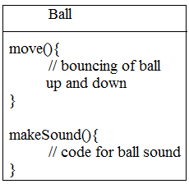
The story of object oriented programming
Now Initially Rajesh is able to finish the task fast. But now there is a small change from Project Manager. Truck and Car will move forward and BackWord, where as Ball will bounse up and down, while moving.
move(ToyType){
// toy is moving
}
Rajesh need to make appropriate changes in move, which will stop functioning of other two.

Slide 15
The story of object oriented programming
Which approach is better, Procedural or OOPs?
Conversation between Rajesh and Dinesh
You have duplicate code, move procedure in all three toy things.
It’s a method not a procedure, and Car, Truck and Ball are classes not things.
I do not agree with you. It is not a good design. You have to maintain three different move() methods. How it can be good?
My friend, you have not seen the final design. Let me show you how OOPs principal (Inheritance) works.

Slide 16
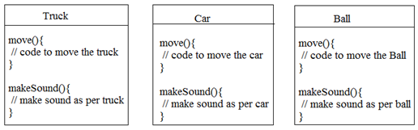
The story of object oriented programming – Inheritance and introduction
Look for the common things in all three toys.
They all are toys.
They have some common features
I can take these common features out and put into common place
And make available that common place to all type of toys.
So finally how my design will look like now

Slide 17
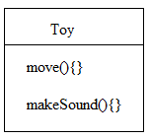
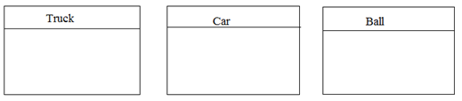
The story of object oriented programming – Inheritance and introduction
Now my final design will look like
You can call them as Truck IS-A Toy, or Car IS-A Toy.
So I do not need to maintain move() and makeSound() methods separately for all three toys.
They will be getting the same functionality as toy, while they are different objects.

Slide 18
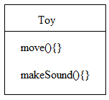
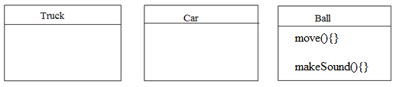
The story of object oriented programming – Method overriding
What about the change in the requirement.
That is the next step of my design. Ball class will override the move() and makeSound() method from Toy class. Then on run time JVM will know exactly which method of which object need to be called.
Don’t you think that it is a real problem.
Ball will bounce up and down, and will not make the same sound as car or truck toy may sound.

Slide 19
The story of object oriented programming – OOPs advantages
What do you like most about OOPs.
It is easy to imagine, and helps to design the problem in more natural way.
Each feature is tested and run separately, so it is easy to add new feature.
I like that the data and methods(), that operate on that data live together in one class.
“Reusing the code in other applications.” when I write a new class, I can make it flexible enough to be used in something new later.

Slide 20
The story of object oriented programming – Think about this
What are the basic things you need to think about when you design a Java class.
What are the questions you need to ask to yourself.
If you could design a checklist to use when you’re designing a class, what would be on the checklist.

Slide 21
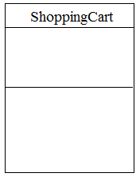
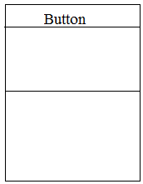
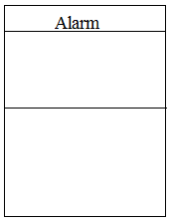
The story of object oriented programming – What is there in the class
Let me tell you
When you design a class, think about the objects that will be created from that class type. Think about
Things the object knows
Things the object does
cartContents
knows
label
color
knows
alarmTime
alarmMode
knows
addToCart()
removeFromCart()
checkOut()
setAlarmTime()
getAlarmTime()
isAlarmSet()
snooze()
stopAlarm()
setColor()
setLabel()
clickOnButton()
doubleClick()
does
does
does

Slide 22
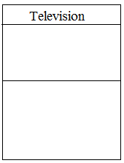
The story of object oriented programming – What is there in the class
Let me tell you
Things that object knows about itself are called
Instance Variable
To identity the instance variables, think about the adjectives.
Things an object can do is called
Method
To identify the methods, think about the verbs.
Let’s take the challenge and think about this.

Slide 23

Objects
Think about the real world situations.
Object-orientation was intended to be closer to the real world, hence, make it easier and more realistic.
What are the object?
Something visible for you, like car, phone, apple, duck etc.
Something that you can’t touch like Time, Event, Account.
“It is an instance of a class”
Each object has it’s own attribute and behaviour.
Each object is separate from other
Each object has it’s own identity and existence

Slide 24
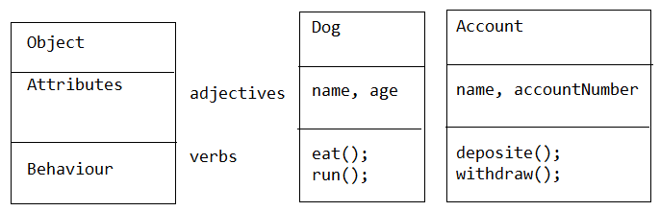
Attribute and behaviour
Attribute is something that describe the object.
Behaviour is something that shows the operation performed by the object.

Slide 25
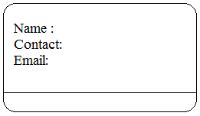
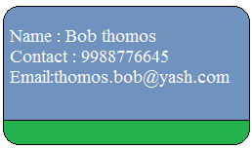
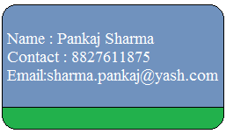
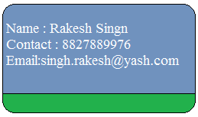
The story of object oriented programming – Difference between class and object
Let’s think about

Slide 26
Practical use case on class and object – testing components using traditional approach
Let’s try to attempt this requirement.
Create a Movie class
Create two fields as movieName (String) and rating (int)
Create playMovie() method
Create MovieTestDrive class to check Movie.
Create three movie objects and test movies
Attempt it using traditional testing approach

Slide 27
Practical use case on class and object – use of main method
Let’s discuss the use of main and objects
If you are in main(), you can not experience the real use of Object Oriented ness.
In real Object Oriented Environment, Objects talk to each other, which you will not experience in main() method.
There are basically two uses of main() method
To test your real class
To launch or start your application
When we say Objects talk to each other, they call the method of other objects.
Let me introduce the sample application to get the real feel of Object Oriented world

Slide 28
Practical use case on class and object – Case study
Number Guessing Game
This game will have Game object and Three Players object. The game will generates a random number between 0 to 9 , and three players will guess the number. Game object will keep on producing number until Player Objects does not guess the correct number.
GuessGame.java Player.java GameLauncher.java
Logic:
The GameLaucher class is a class that will start the Game (having main() method)
In the main () method, a GuessGame object is created and it’s startGame is called.
The GuessGame object’s startGame() method is where the entire game plays out. It creates three players, then think of a random number (the target of the players to guess). It then asks each player to guess, check the result, and either prints out information about the winning player(s) or ask them to guess again.

Slide 29
The story of object oriented programming – APIE
Let me tell you about APIE
While reading
A – Abstraction
P – Polymorphism
I – Inheritance
E – Encapsulation
While understanding

Slide 30
The story of object oriented programming – Encapsulation
Encapsulation implies the idea of hiding the content of a Class, unless it’s necessary to expose. We need to restrict the access to our class as much as we can, so that we can change the properties and the behaviours only from inside the class.
Demo of Encapsulation

Slide 31
The story of object oriented programming – Encapsulation
Encapsulation implies the idea of hiding the content of a Class, unless it’s necessary to expose. We need to restrict the access to our class as much as we can, so that we can change the properties and the behaviours only from inside the class.
Purpose of Encapsulation:
To achieve robustness
Demo of Encapsulation

Slide 32
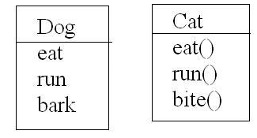
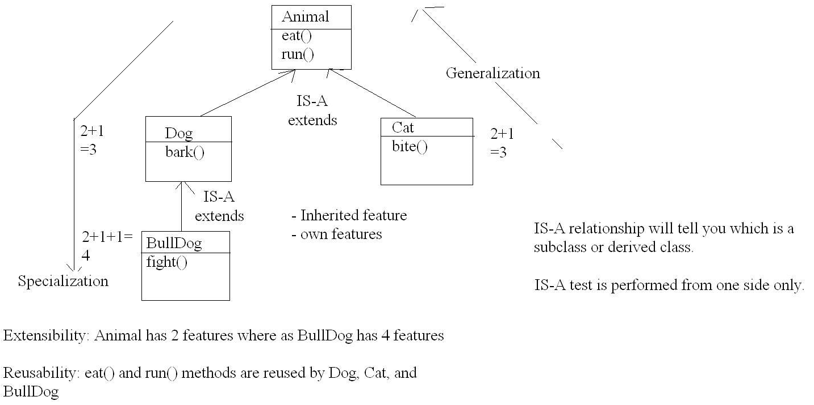
The story of object oriented programming – Inheritance (IS-A Relation)
Inheritance is inheriting the common properties and behaviours, so that we can create a new class, but instead of writing it from scratch, we can base it on an existing class.
Purpose of Inheritance:
Reusability of code
Extensibility of features
Customization in application for future changes.
Inheritance Demo

Slide 33
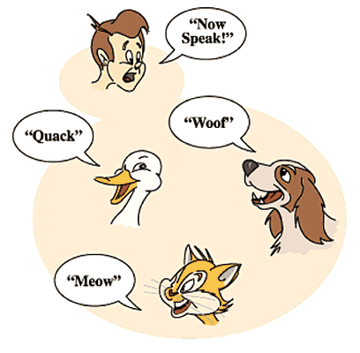
The story of object oriented programming – Polymorphism)
Polymorphism; is the state where an object can take the shape of many different forms, and lets us do the right thing at the right time.
If you have Animal class, and inheriting classes; Dog, Cat, & Duck. Each of the inheriting classes override the speak method (as each animal has a different voice).
Now, we can call the speak method on any animal object, without knowing exactly what class the animal object was instantiated from, and it will do the correct behaviour.
Polymorphism is the flexibility, that triggers the correct behaviour.

Slide 34
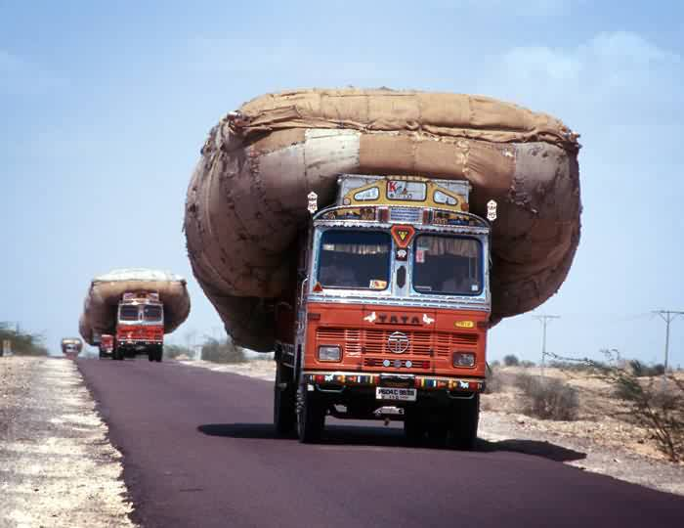

The story of object oriented programming – Polymorphism)
Type of polymorphism
Compile time
Static linking
Early binding
------------------------
Method overloading
Runtime
Dynamic linking
Dynamic binding
------------------------
Method overriding
Purpose
To utilize the system more than its capacity
Purpose
To achieve the customization in application
Polymorphism Demo

Slide 35
The story of object oriented programming – Abstraction)
Abstract class
Interface
Purpose :
To share the common or default features among multiple objects
Purpose :
It works as a contract and provides the highest level of abstraction
Abstraction Example
Abstraction Demo

Slide 36
System modelling
System modelling is a process of developing models for the system.
Each model represents different perspective of the system.
System modelling provides the detail and represents the abstract representation of the system.
UML
Advantages
Used during the analysis process to extract the requirement
During the design process to describe the system to engineers
After implementation to document the system structure and operation

Slide 37
UML
Standard modelling language for Object-Oriented modelling
Many diagrams
Use Case Diagram
Shows the interaction between system and its environment(users or system)
Class Diagram
Shows different objects, their relationship, their attributes and behaviour
Sequence Diagram
Shows the interaction between different objects in the system, and between actors and the objects in a system
State machine Diagram
Shows how the system respond to external and internal events.
Activity Diagram
Shows the flow of the data between the process in the system

Slide 38
Design Principles
“Set of guidelines whose purpose is to have better design”
Why principles are required?
If you have a situation where inheritance can be used, but if you don’t use instead you create multiple classes, then what will happen?
If you make every member of a class as public and violate the encapsulation rule, what will happen?
If you combine every single concept in your application into one massive class that acts like a completely procedural concept, what will happen?

Slide 39
Design Principles…..
In each case, application will still work. But ! There are certain issues that your will encounter.
You will be creating code that is hard to read.
Code that can be broken easily.
Code will be much harder to maintain.
Basic bug fixing or adding new feature will be a tedious job.
There are chances that small change can break the whole system.
For minimising the above issues, there are certain object oriented guidelines which will result the better design.

Slide 40
Design Principles…..
KISS
It means “Keep It Simple and Short”
Most systems work best if they are kept simple rather than complex.
Simplicity should be a key goal in design and unnecessary complexity should be avoided.
Advantages of Simplicity
System will be easier to maintain and debug
System will be easier to test
Easier to be documented
Imagine if after few weeks of development you are asked to fix some of the issues.

Slide 41
Design Principles…..
DRY
It means “Don’t Repeat Yourself”
Try to avoid any duplicates. Instead you put them into a single part of the system or a method.
Imagine that you have copy pasted the same code on 100 places, now what will happen in case of change.
Single Source of Truth

Slide 42
Design Principles…..
SOLID
S – Single Responsibility
O – Open/ Closed Principle
L – Liskov Substitution principle
I – Interface segregation principle
D – dependency inversion principle
Single Responsibility Principle
An object should have one and only one responsibility
One object can have multiple methods, but all those methods will be having relevant functionality
In case of change that need to happen only intended object need to be modified.

Slide 43
Design Principles…..
SOLID
S – Single Responsibility
O – Open/ Closed Principle
L – Liskov Substitution principle
I – Interface segregation principle
D – dependency inversion principle
Open / Closed Principle
Software entities (class, modules, functions etc) must be open for extension and close for modification.
In case you want to add additional behaviour, or methods you should not modify the existing one, rather you should write the new functionality.
DI in Spring

Slide 44
Design Principles…..
SOLID
S – Single Responsibility
O – Open/ Closed Principle
L – Liskov Substitution principle
I – Interface segregation principle
D – dependency inversion principle
Liskov Substitution Principle
parent class functionality can be used as it is by child class.

Slide 45
Design Principles…..
SOLID
S – Single Responsibility
O – Open/ Closed Principle
L – Liskov Substitution principle
I – Interface segregation principle
D – dependency inversion principle
Interface Segregation Principle
Interfaces should be specific rather than doing many and different things.
Large specific interfaces should be decompose into smaller, more specific one

Slide 46
Design Principles…..
Coupling and Cohesion
Loose coupling and high cohesion is recommended

Slide 47
Thank you!

